Slide 1
SPRING 2024 Returning Safety Officer Training

Slide 2
Agenda
Updates
Skills Review
Questions
Reminders
Notes:
Chris

Slide 3
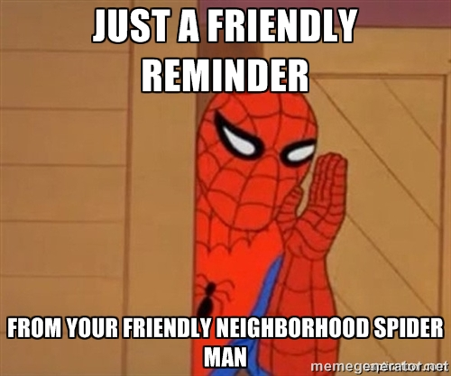
Reminders
If you need more supplies for your First Aid Kit – please bring it in to Jenny!
You need to make sure your CPR cert stays up to date
Facility staff are just there to provide ice, and to assist in calling 911 if needed – the rest is up to you. This includes:
Accident Reports
Providing Care
We need to call an ambulance for the following:
Broken/dislocated body parts
Bleeding we cannot stop
Loss of consciousness
Anything you are not comfortable providing care for

Slide 4
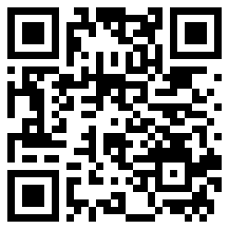
FREE PHYSICALS
Date: Wednesday, January 31
Time: 5pm – 7pm
Location: RAC – Overlook Classroom
Scan QR Code to Reserve Spot
Drop-ins will be welcome, but there is no guarantee they will be seen.

Slide 5
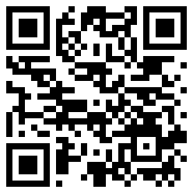
Upcoming first/cpr/aed certification courses
Class Date: Saturday, February 3
Time: 10am – 2pm
Location: Aquatic & Fitness Center (AFC)
Cost: FREE
Register before January 30 via this QR Code.

Slide 6
INCLEMENT Weather/EMERGENCY CLOSING Policy #2207
All scheduled club activities will be canceled during university closures due to inclement weather. This includes practices or competitions held off-campus.

Slide 7
Cold Weather Policy
All competitive sports events at George Mason operate under the guidelines highlighted in the following table. In the event that a certified athletic trainer is not present, please utilize the following table (from 2014-2015 NCAA Sports Medicine Handbook) to determine the guidelines recommended for your game/practice conditions.

Slide 8
COLD weather policy continued
Outside "Real-Feel" Temperature | Guidelines/Adjustments
32°- 26°F | -Be aware of the potential for cold injury and notify appropriate personal of the potential.
25° - 16°F | -Participants should wear additional protective clothing including long sleeves, pants, gloves, and hats when practical. -Practice: provide opportunities and facilities for re-warming every 60 minutes for at least 10 minutes. -Game: provide opportunities and facilities for re-warming each half with the re-warming period lasting at least 15 minutes. Limit warm-up time prior to game if possible.
15° - 1°F | -Comply with previous clothing recommendations. -Warm-up and cool down activities should be considered indoors if possible. -Practice: Modify activity to limit exposure and to allow more frequent chances to re-warm every 45 minutes for at least 10 minutes. Move practice inside if possible. -Game: Must have a 10-minute re-warming period after warm-up prior to game. Must have re-warming period at half-time for at least 15 minutes. Participants are encouraged to change into dry base layers at the half. -If precipitation is expected consider cancelling activity or move inside if possible.
0° and Below | -Terminate and reschedule activity or move inside if possible.

Slide 9
EAP – Mason Rec Facility
First responder stops activities and provides treatment
First responder designates individual to call EMS
First responder designates individual to obtain FA Kit and AED
Indoor facilities – notify Manager on Duty
West Campus – notify field supervisor
First aid provided until EMS arrives
Post-Incident
Complete Accident/Incident report
Call Competitive Sports administrator
First responder stops activities and provides treatment
First responder designates individual to provide notice of treatment
First responder designates individual to obtain FA Kit and AED
Indoor facilities – notify Manager on Duty
West Campus – notify field supervisor
Ask patient if they would like EMS to be called
Post-Incident
Complete Accident/Incident report
Call Competitive Sports administrator if you feel necessary
AT will take over care when present
Monitor patient
Refer to “Life-Threatening” procedure if condition deteriorate
Life Threatening
Non-Life Threatening
Notes:
Paul

Slide 10
EAP – Non-Mason Rec Facility
Before activity, be aware of venue’s EAP, location of emergency equipment
First responder designates two individuals
First responder designates individual to obtain FA Kit and Aid
First aid provided until EMS arrives
Post-Incident
Complete Accident/Incident report
Call Competitive Sports administrator
Call EMS
Meet EMS at facility entry and guide to location
First responder stops activities and provides treatment
First responder determines if additional support is needed
First responder designates individual to obtain FA Kit and AED
Stays with patient while support is obtained
Ask patient if they would like EMS to be called at their own expense
Post-Incident
Complete Accident/Incident report
Call Competitive Sports administrator
Monitor patient
Refer to “Life-Threatening” procedure if conditions deteriorate
Life Threatening
Non-Life Threatening
Notes:
Paul

Slide 11
SCENARIO 1
A club soccer player twists their ankle while attempting to change direction quickly. They are in visible pain, cannot bear weight on the injured foot, and the ankle begins to swell.

Slide 12
SCENARIO 1 - ANSWER
Ankle Sprain During a Soccer Practice
Immediate Response: Stop the player from continuing the game and help them to a safe area avoiding pressure on the injured ankle.
First Aid: Apply the RICE method - Rest, Immobilize, Cold, and Elevation. Use a cold pack or ice wrapped in a cloth on the injured area for about 20 minutes. *Where can you find ice?
Assessment: Check for signs of more severe injury like deformity or inability to move the ankle.
Follow-Up: Advise the player to see a medical professional for further evaluation, especially if they can't bear weight on the ankle.
Documentation: Complete accident report in Connect2.

Slide 13
SCENARIO 2
During a club basketball practice, two players collide while jumping for a rebound. One player hits their head on the floor and is momentarily dazed, complaining of a headache and feeling slightly nauseous.

Slide 14
SCENARIO 2 - ANSWER
Head Injury in Basketball
Immediate Response: Remove the player from the game and have them rest in a quiet, comfortable position.
Assessment: Look for signs of concussion, such as headache, confusion, dizziness, nausea, or loss of consciousness.
First Aid: Monitor the player closely for worsening symptoms. Avoid giving them painkillers which might mask symptoms.
Follow-Up: The player should see a healthcare professional as soon as possible for a full evaluation.
Documentation: Submit accident report in Connect2. For severe cases or loss of consciousness, call 911 and notify Club Sport Admin.

Slide 15
SCENARIO 3
A swimmer suddenly stops during a training session, clutching their chest. They are experiencing sharp chest pain and are having difficulty breathing.

Slide 16
SCENARIO 3 - ANSWER
Chest Pain During Swimming Practice
Immediate Response: Help the swimmer out of the pool and have them rest in a comfortable position. Seek assistance from lifeguard staff.
Assessment: Ask about the nature of the pain, any history of heart problems or asthma, and look for other symptoms like difficulty breathing or pain radiating to other parts of the body.
First Aid: Call 911 immediately if you suspect a heart-related issue.
Follow-Up: Monitor the swimmer closely while waiting for emergency services. Do not give them food, drink, or medication.
Documentation: Complete accident report in Connect2. Contact Club Sport Admin if EMS is called.

Slide 17
SCENARIO 4
A player develops hives, begins wheezing, and complains of a tightening throat shortly after consuming a snack. They have a known allergy to nuts and suspect they may have inadvertently eaten something containing nuts.

Slide 18
SCENARIO 4 - ANSWER
Severe Allergic Reaction at a Tennis Match
Immediate Response: If the player has an epinephrine auto-injector (EpiPen), assist them in using it immediately.
First Aid: Call for emergency medical help. Keep the player calm and lying down.
Assessment: Monitor for worsening symptoms like difficulty breathing, swelling of the face or throat, or loss of consciousness.
Follow-Up: Stay with the player until medical help arrives. Note down what they ate and any other relevant information for the medical team.
Documentation: Complete accident report in Connect2. Contact Club Sport Admin if EMS is called.

Slide 19
SCENARIO 5
It's a particularly hot day, and a runner finishes a long-distance race looking extremely fatigued, disoriented, and complaining of dizziness. They have profuse sweating and their skin is hot, clamming and/or dry.

Slide 20
SCENARIO 5 - ANSWER
Heat Exhaustion at a Track Meet
Immediate Response: Move the athlete to a cooler, shaded area or indoors to AC.
First Aid: Have them lie down and elevate their legs. Remove any excess clothing and apply cool, wet cloths to the skin. Provide cool water or sports drinks if they are conscious and can drink.
Assessment: Monitor vital signs like pulse and breathing. Look for signs of heatstroke (e.g., lack of sweating, confusion, loss of consciousness).
Follow-Up: If symptoms do not improve quickly, or if heatstroke is suspected, seek emergency medical attention.
Documentation: Complete accident report in Connect2. Contact Club Sport Admin if EMS is called.

Slide 21
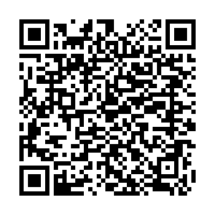
Connect2 Accident Form: Review
Connect2 Accident Form Link
Must be submitted for every injury
If any first aid is provided, an injury has occurred
Video Walkthrough
Complete Sentences
Accurate Descriptions
Do Not Make Diagnoses
Succinct
Notes:
Paul

Slide 22
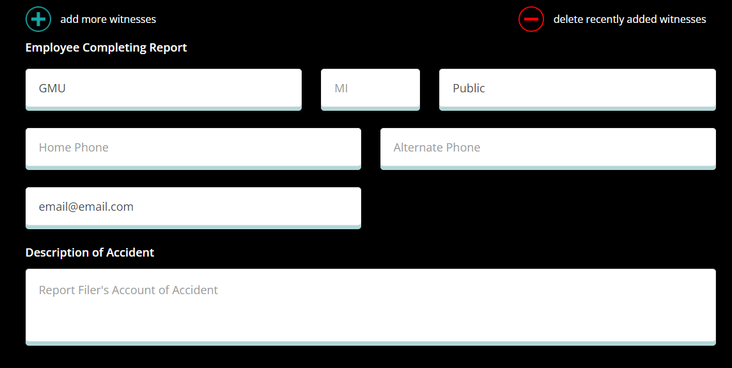
Accident Report Write-Up Example:
"Athlete was hit in the face with a field hockey stick while playing field hockey on field 3 during a camp. The athlete walked to the sideline on her own. Significant facial bleeding. She reported blurry vision and dizziness. Approximately 2 inch facial laceration on her forehead. She was alert and oriented. The athletic trainer on site for the camp attended to the athlete. The Outdoor Supervisor and myself arrived at the field after being at the pavilion as the athletic trainer was attending to the athlete. Bleeding was controlled and steri-strips applied for transport to ER for stitches. Verbal authorization from athlete’s mother obtained for the athletic trainer and camp director to transport. EMS transport was denied. Mother was to meet them at the ER. The athletic trainer assisted with checking in the athlete to the ER. ER staff was beginning initial assessment."

Slide 23
Contacting Professional Staff
Facility Numbers
Field Supervisor/Outdoor Supervisor: 571-335-6649
RAC Front Desk: 703-993-5323
Field House Front Desk: 703-993-3222
Admin Emergency Numbers
Paul Cell: 703-509-5688
Colin Cell: 443-852-8166
Jenny Cell: 703-209-1168
Police Involvement
EMS or Hospital Visit
Lodging Issues
Car Accidents/Issues
Altercations in Games
Alcohol-Related Issues
Notes:
Paul

Slide 24
Questions?
Free physical dates:
Wednesday, August 31rd from 5 - 7pm
They will occur in the RAC in The Overlook.
Please have interested members register online on Mason360. We will allow walk-ins but a physical is not guaranteed
All members must register as an individual on their own behalf. Teams cannot batch register their athletes.

